Slide 1

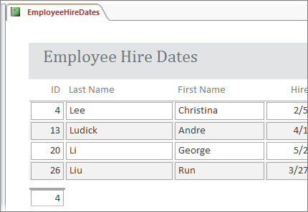
OCR Level 02 – Cambridge Technical
Unit 05 – Creating business solutions
2016 Specification - L/615/1355
LO2 - Be Able to Design Solutions to Meet Business Needs

Slide 2
Assessment Criteria
The Learner will | Pass The assessment criteria are the pass requirements for this unit. The learner can: | Merit To achieve a merit the evidence must show that, in addition to the pass criteria, the learner is able to: | Distinction To achieve a distinction the evidence must show that, in addition to the pass and merit criteria, the learner is able to:
1. Understand the role of the digital Business Practitioner | P1: Describe how the digital business practitioner supports business.
2. Be able to design solutions to meet business needs | P2: Design a solution to meet the identified business need. |  | D1: Justify how the design proposal supports the business needs.
3. Be able to present business solutions to stakeholders | P3: Create a prototype of the proposed business solution. | M1: Modify the design in response to stakeholder feedback.
 | P4: Present the prototype to identified stakeholders.
4. Be able to use IT applications to meet business needs. | P5: Create the proposed business solution. | M2: Test the solution to confirm functionality. | D2: Assess the appropriateness of the solution to the business need.
 | P6: Gather feedback from stakeholders of the proposed solution.

Slide 3
Assessment Criterion P2, D1
P2 - The learner is required to design the solution to meet the identified business needs. It is important that the learner is provided with a scenario which they can analyse sufficiently to identify what the business need is and then proceed to design the solution. Alternatively, learners could question a “stakeholder” to obtain information on what is required. The evidence could be presented as a report or include notes of discussions, a presentation of the analysis and final decision and design documentation.
D1 - The learner is required to justify how the design proposal supports the business needs. This may be included within the evidence for P3 but must give good reasons why the design will support the business needs.

Slide 4
LO2 - Assessment Criterion
2.1. General IT applications, e.g.:
  word processing
  presentations
  spreadsheets
  databases
2.2. Business IT applications, e.g.:
  accounting software
  customer relationship management
  business dashboard
  inventory software
  management information systems
  human resource management systems.
2.3. Business needs, e.g.:
  dissemination of information to internal and external clients, e.g. letters, reports, posters, memoranda
  controlling stock
  managing staff, e.g. staff development, salary scales, legal and regulatory requirements such as minimum wage, national insurance contributions, personal details
  Purchasing, e.g. supplier details, prices, discounts, supplier reliability
  Sales, e.g. customer details, discounting arrangements, customer orders, monitoring of sales and sales process
  financial management, e.g. planning, monitoring and controlling all of the monetary assets of the organisation.
2.4. Choose the most appropriate IT application or combination of IT applications for a given business need
2.5. Stages in designing a possible solution i.e.:
  check with the client what is required
  analyse the problem to make sure that the IT applications selected are the most appropriate
  consider the different ways in which the solution may be met
  select the solution which most clearly meets the needs identified
  prepare the work plan, e.g. individual steps to be taken, i.e. objective (the solution), targets (how you know the objective has been met), tasks that have to be undertaken to ensure the objective is met, resources required to meet the objectives, timelines (the time by which a particular task must be completed), individual responsibilities
  document the design
  justify approach taken.

Slide 5
Unit 05 - Scenario
IT applications are commonly found in businesses. Digital practitioners play an important role in supporting businesses. You will design and create a business solution in conjunction with a stakeholder.
Progress Solutions for Business
Progress Solutions for Business is an existing organisation that offers administration services for businesses and organisations, as well as creating business solutions. The staff consists of:
  a manager who has overall control of the organisation and also markets Progress Solutions for Business to external clients;
  a supervisor who oversees the work of the administrative staff;
  six administrative staff who provide the administration services.
It provides the following services:
  word processing of reports and letters;
  production of leaflets and brochures with graphical images;
  creation of presentations which could include graphical images, video and audio clips and animations;
  spreadsheet solutions;
  database solutions;
  website creations;
  social media consultancy;
  business IT applications.
A client, Westwood Recruitment Services (WRS), is an employment agency which specialises in providing staff for the hospitality industry. The agency has vetted the CVs supplied to them by applicants to match these with a potential job role e.g. chef. When an employer has a vacancy for a job such as a chef, WRS will let applicants know about the job role and find out if they wish to be interviewed for the position. WRS will set a closing date, and after the closing date it will arrange interviews for all the applicants interested in the post, sending them a letter inviting them for interview. The letter will inform the applicant about the location, date and time of the interview, as well as any other key details that may be relevant.

Slide 6
LO2 – Learning Outcome
Learning Outcome 2: Be able to design solutions to meet business needs
Your task is to: design a solution for Westwood Recruitment Services (WRS) to allow it to store details of applicants and the posts that they would be eligible to apply for. The design should allow WRS to record if an applicant wishes to be invited for an interview for a specific job, such as a chef, when it becomes available with a particular employer. The solution you design must be able to create a letter to each applicant interested in applying for the job, to advise them of details relating to the interview.
Justify why your design is appropriate for WRS.
Pass | Merit | Distinction
P2: Design a solution to meet the identified business need |  | D1: Justify how the design proposal supports the business needs
Evidence
A report to include notes of discussions, or a presentation of the analysis and final solution and design documentation. This must include: details of the IT software to be used; design of a possible solution; justification why the solution you have designed meets the identified business need.

Slide 7
P2.1 – General IT Applications
A client, Westwood Recruitment Services (WRS), is an employment agency which specialises in providing staff for the hospitality industry.
  The agency has vetted the CVs supplied to them by applicants to match these with a potential job role e.g. chef.
  When an employer has a vacancy for a job such as a chef, WRS will let applicants know about the job role and find out if they wish to be interviewed for the position.
  WRS will set a closing date
  And after the closing date it will arrange interviews for all the applicants interested in the post, sending them a letter inviting them for interview.
  The letter will inform the applicant about the location, date and time of the interview, as well as any other key details that may be relevant.
P2.1 – Task 01 - For each of the criteria above, describe how General IT applications could be used in the production of the solution.
  Word processing (letters, reports, marketing materials)
  Presentations (job interviews, job presentations)
  Spreadsheets (collecting and producing tables and charts)
  Databases (listing, querying and filtering candidates)
Are you up to date with new technology How many IT jobs will there be in the future Who makes webpages manually these days In your lifetime you will see dramatic technology changes Your children will think you are very out of date.

Slide 8
P2.2 – Business IT Applications
For the client, how would the following Business IT applications be used to streamline the process of sorting, querying and setting interview for staff.
  accounting software (software that is responsible for the managing of money, order, deliveries and payments including wages)
  customer relationship management (software designed to monitor, track and predict what the customers are likely to do, and keep the company in contact with them to maintain repeat business)
  business dashboard (a menu system designed to ease the process of completing tasks, customised for the users needs)
  inventory software – software that tracks the deliveries and sales of goods in and out of the company, reorders when stocks are low and monitors peak and low points)
  management information systems – deals with everything to do with staff, medial, work related, contact details, and training)
  human resource management systems (training, incidents, managing staff, line managing and department planning)
P2.2 – Task 02 – In terms of Business IT Applications, what functions in the solution of the IT scenario can these applications present.
Are you up to date with new technology How many IT jobs will there be in the future Who makes webpages manually these days In your lifetime you will see dramatic technology changes Your children will think you are very out of date.

Slide 9
P2.3 – Business Needs
  The WRS client have very specific needs that a software solution can help solve. Before you can produce or propose a solution you will need to create a report that outlines their application needs. For this you will need to look at the scenario and break down the following into technical problems.
  dissemination of information to internal and external clients, e.g. letters, reports, posters, memoranda
  controlling stock
  managing staff, e.g. staff development, salary scales, legal and regulatory requirements such as minimum wage, national insurance contributions, personal details
  Purchasing, e.g. supplier details, prices, discounts, supplier reliability
  Sales, e.g. customer details, discounting arrangements, customer orders, monitoring of sales and sales process
  financial management, e.g. planning, monitoring and controlling all of the monetary assets of the organisation.
P2.3 – Task 03 – In terms of Business Needs and the WRS scenario, create a report that outlines the client’s digital specification.
For example, they are looking for a solution to controlling stock. They are an employment agency that recruits staff for the hospitality industry (hotels, restaurants, functions etc.) and they will have a lot of staff on their books. In terms of stock management they will need office stationary (paper, pens etc.) files, folders, contracts etc. and all this needs tracking so they do not overstock or run out.
You need to draw up a report on the problem and the potential digital solution based on the previous two tasks. Ask your teacher to be the manager of WRS and ask questions.

Slide 10
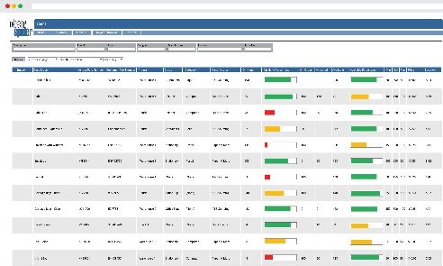
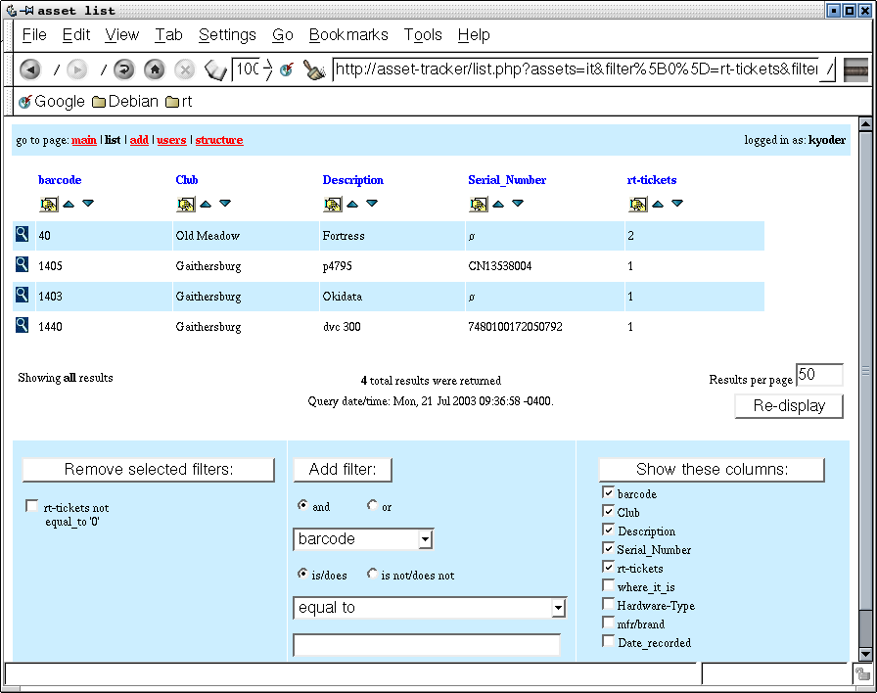
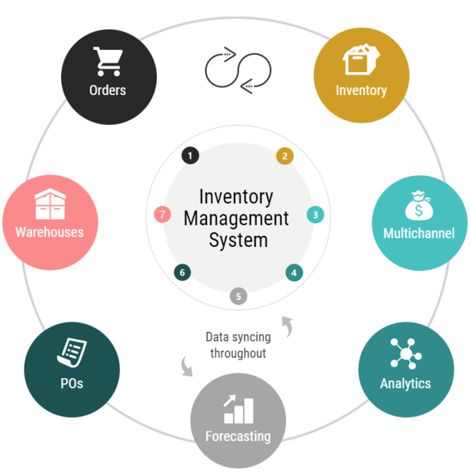
P2.4 – Business Needs
  For P2.4 you need to sue the scenario needs and produce a potential digital solution for each of the issues. In doing so you need to specify the need again, and the potential solution, describing how the general or business application could be used to create a solution.
P2.4 – Task 04 – In terms of Business Needs and the WRS scenario, create a report that outlines the client’s potential application or general digital solution to the problem.
For example, they are looking for a solution to controlling stock. They are an employment agency that recruits staff for the hospitality industry (hotels, restaurants, functions etc.) and they will have a lot of staff on their books.
In terms of the solution they might incorporate, they could either computerise the stock inventory into a standard database or spreadsheet and have someone track the number of stock on a regular basis, this means creating a query on stock numbers and a regular report.
Otherwise they could incorporate an inventory management system with reorder points. This would track each inventory item as it left the store and order more before needed on important items. The solution would be more effective but costly to incorporate.
Spreadsheet solution
Database solution
IMS solution

Slide 11
P2.5 – Business Scenario
  Design a solution for Westwood Recruitment Services (WRS) to allow it to store details of applicants and the posts that they would be eligible to apply for. The design should allow WRS to record if an applicant wishes to be invited for an interview for a specific job, such as a chef, when it becomes available with a particular employer. The solution you design must be able to create a letter to each applicant interested in applying for the job, to advise them of details relating to the interview.
  For this scenario, WRC needs something that will cater for all the following tasks:
  To store details of applicants and the posts that they would be eligible to apply for.
  To record if an applicant wishes to be invited for an interview for a specific job, such as a chef, when it becomes available with a particular employer.
  To create a letter to each applicant interested in applying for the job
  The letter needs to advise them of details relating to the interview.
  For this think about each task and if there is a way to have them all automated, or at least have the information created be compatible with each section of the solution.
  For example you might use a spreadsheet for task 1, with a tick box field for task 2, with a column for potential employers, a lookup for their addresses, have this mail merge into a prepared letter for stage 4 that picks the information up from the spreadsheet.
  Or you could do it all with a database file, a table for task 1, a table for task 2 with a tick box and preferred employer field, and a mail merge letter for task 3 picking information from a third table of employer details for task 4.

Slide 12
P2.5 – Stages in designing a possible solution
  Preparing a proposal solution for a problem needs careful planning. You need to follow stages to make sure the proposal needs, client needs and scenario needs are met for it to be accepted.
    check with the client what is required
    analyse the problem to make sure that the IT applications selected are the most appropriate
    consider the different ways in which the solution may be met
    select the solution which most clearly meets the needs identified
    prepare the work plan, e.g. individual steps to be taken, i.e. objective (the solution), targets (how you know the objective has been met), tasks that have to be undertaken to ensure the objective is met, resources required to meet the objectives, timelines (the time by which a particular task must be completed), individual responsibilities
    document the design (outline the stages of the solution)
    justify approach taken (justify the solution method against other possible solutions)
  P2.5 – Task 05 - For the given scenario create a 7 stage proposal that includes the problem, and possible solution.
  In this task outline each stage of the solution in the process and use the stages list as headings for your proposal report..

Slide 13
D1.1 – Justifying Proposal Design
  Using the conclusion of the scenario proposal report in Task 05, explain in detail why this proposed solution is capable of working. Create a conclusion report answering the following questions.
    Why do you think this solution is appropriate.
    Does this solution cover all the tasks of the client.
    What technical difficulties might there be with this solution.
    What software and hardware will need to be used for this solution.
    Is this solution going to be technically difficult to set up.
    Does the solution involve more than one program to complete the task.
    Does the solution require a high level of technical ability to create and use.
    Will the solution require staff to be trained.
    Can you foresee any problems with creating this solution.
    What other potential solutions could have been used.
  D1.1 – Task 06 - Justify why your design is appropriate for WRS.

Slide 14
LO2 – Assessment Criteria
  P2.1 – Task 01 - For each of the criteria above, describe how General IT applications could be used in the production of the solution.
  P2.2 – Task 02 – In terms of Business IT Applications, what functions in the solution of the IT scenario can these applications present.
  P2.3 – Task 03 – In terms of Business Needs and the WRS scenario, create a report that outlines the client’s digital specification.
  P2.4 – Task 04 – In terms of Business Needs and the WRS scenario, create a report that outlines the client’s potential application or general digital solution to the problem.
  P2.5 – Task 05 - For the given scenario create a 7 stage proposal that includes the problem, and possible solution.
  D1.1 – Task 06 - Justify why your design is appropriate for WRS.

